Slide 1
Praktikum Basis Data
SQL Server with SSMS

Slide 2

SQL Server Core Features
Tables
Views
Constraints, Primary and Foreign Keys
Indexes
Stored Procedures and Functions
Triggers
SQL Server Identity Columns
Temporary Objects
Defaults
Users
User-defined Types
Read more at https://www.microsoft.com/en-us/sql-server/sql-server-2019-features

Slide 3
SQL Server Native Client
SNAC, or SQL Server Native Client, is a term that has been used interchangeably to refer to ODBC and OLE DB drivers for SQL Server.
Implements support for SQL Server features:
Tabular Data Stream implementation
Mirrored SQL Server databases
All data types supported by SQL Server
Asynchronous operations
Query notifications
Encryption
Receiving multiple result sets in a single database session

Slide 4
SQL Server Services
Machine Learning
Service Broker
Replication
Analysis
Reporting
Notification
Integration
Full Text Search
SQLCMD
Visual Studio
SSMS
SQL Server Operations Studio
BI Development Studio

Slide 5
SQL (Structured Query Language)
SQL is a domain-specific language used in programming and designed for managing data held in a relational database management system, or for stream processing in a relational data stream management system
Category of SQL Command / Query in SQL Server:
DML (Select, Update, Insert, Delete)
DDL (Create, Alter, Drop, Truncate)
DCL (Grant, Revoke)
TCL (Begin, Commit, Rollback, Save)

Slide 6

SQL Server + T-SQL
Transact-SQL (T-SQL) is Microsoft's and Sybase's proprietary extension to the SQL (Structured Query Language) used to interact with relational databases. T-SQL expands on the SQL standard to include procedural programming, local variables, various support functions for string processing, date processing, mathematics, etc. and changes to the DELETE and UPDATE statements.

Slide 7
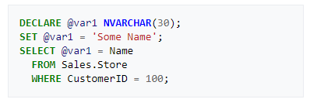
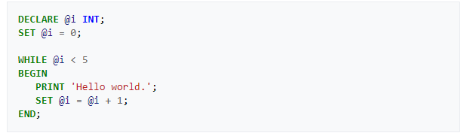
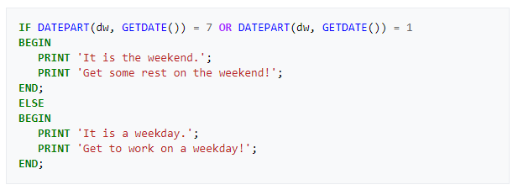
T-SQL Example

Slide 8
SQL Server PolyBase
PolyBase enables your SQL Server instance to process Transact-SQL queries that read data from external data sources. SQL Server 2016 and higher can access external data in Hadoop and Azure Blob Storage. Starting in SQL Server 2019, you can now use PolyBase to access external data in SQL Server, Oracle, Teradata, and MongoDB.

Slide 9
SQL Server Environtment
Like others database engines

Slide 10
SQL Server Environtment
Database
A database is an organized collection of data, generally stored and accessed electronically from a computer system.
Table
A database table is just that, a table with rows and columns. Different tables contain information about different types of things.
Column
The columns in a table are the set of facts that we keep track of about that type of object. A column is also called an attribute.
Row / Tuple
Each row in a database table represents one instance of the type of object described in that table. A row is also called a record.

Slide 11
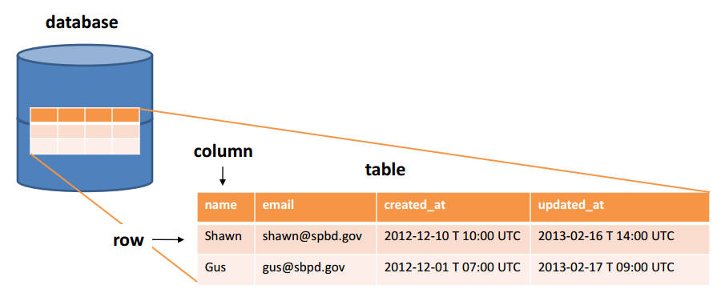
SQL Server Environtment

Slide 12
SQL Server Environtment
Type Data
In SQL Server, each column, local variable, expression, and parameter has a related data type. A data type is an attribute that specifies the type of data that the object can hold: integer data, character data, monetary data, date and time data, binary strings, and so on.
Dikelompokkan menjadi beberapa kategori:
Exact numerics (bit, int, decimal, numeric, smallint)
Unicode character strings (nvarchar)
Approximate numerics (float, real)
Binary strings (binary, image)
Date and time (date, datetime)
Character strings (char, text)
Other data types (cursor, table, xml)

Slide 13
SQL Server Environtment
Null & Not Null
A field with a NULL value is a field with no value
Null tidak berarti dan sangat berbeda dengan nol. NULL berarti kosong atau belum diisi.
Not Null is column that cannot be NULL

Slide 14
SQL Server Environtment
Primary Key (Simple)
A primary key is a column or a group of columns that uniquely identifies each row in a table.
Primary Key (Composite)
Composite key is a key which is the combination of more than one field or column of a given table.
Foreign Key
A FOREIGN KEY is a field (or collection of fields) in one table that refers to the PRIMARY KEY in another table.
Unique Key
The UNIQUE constraint ensures that all values in a column are different.
PRIMARY KEY pasti memiliki constraint UNIQUE, tetapi UNIQUE belum tentu adalah PRIMARY KEY

Slide 15
SQL Server Environtment
Reference Integrity
Referential integrity is the ability to take appropriate actions when tables or records involved in a relationship are affected.
There’s many type of referential integrity:
No Action – Seperti namanya, will throws error
Cascade – Automatically applied to dependent table rows
Set Default – Set to column default value
Set Null – Set column to NULL

Slide 16
SQL Server Environtment
Identity Column
Auto Increment on MySQL
The MS SQL Server uses the IDENTITY keyword to perform an auto-increment feature
Example syntax is IDENTITY(1, 1), mean the starting value for IDENTITY is 1, and it will increment by 1 for each new record
So, IDENTITY(x, y) have meaning the starting value of IDENTITY is x, and it will increment by y for each new record

Slide 17
SQL Server Environtment
CHECK Constraints
The CHECK constraint is used to limit the value range that can be placed in a column
For example column age have CHECK constraint age >= 18 to ensure that the age of user must be 18, or older

Slide 18
SQL Server Environtment
CTE (Common Table Expression)
A CTE allows you to define a temporary named result set that available temporarily in the execution scope of a statement such as SELECT, INSERT, UPDATE, DELETE, or MERGE.
A recursive common table expression (CTE) is a CTE that references itself. By doing so, the CTE repeatedly executes, returns subsets of data, until it returns the complete result set.
Example: Tampilkan nama-nama hari dari hari Senin sampai Minggu dengan menggunakan rekursif
WITH expression_name[(column_name [,...])] AS (CTE_definition) SQL_statement;

